Slide 1
Cse4022 natural language processing j comp review 3
Name:- uday singh shergill
Reg. no:- 20BCE1806
Topic:- language detection using ML/NLP
Video link for presentation:- https://drive.google.com/file/d/1e-BafGQtKoYWf0aY-DGozk9FQtD-WYfB/view?usp=share_link

Slide 2
INTRODUCTION
Speech recognition is a natural language processing task that requires identifying the language of a text or document. Using machine learning for speech recognition was a difficult task a few years ago due to the lack of much data on language, but now that data is readily available, several powerful machine learning models are already available.
As humans, we can easily recognize the languages ​​we know. For example, I can easily recognize Hindi and English, but as an Indian I cannot recognize all Indian languages. Here you can use speech recognition tasks. Google Translate is he one of the most popular language translators in the world, used by so many people around the world. It also includes a machine learning model for language recognition, which you can use if you don’t know the language you want to translate.
The most important part of training a speech recognition model is the data. The more data for each language, the better the real-time accuracy of the model. The dataset I’m using was collected by Kaggle and contains data on 22 common languages, 1000 sentences in each language, and a machine learning speech recognition model.

Slide 3
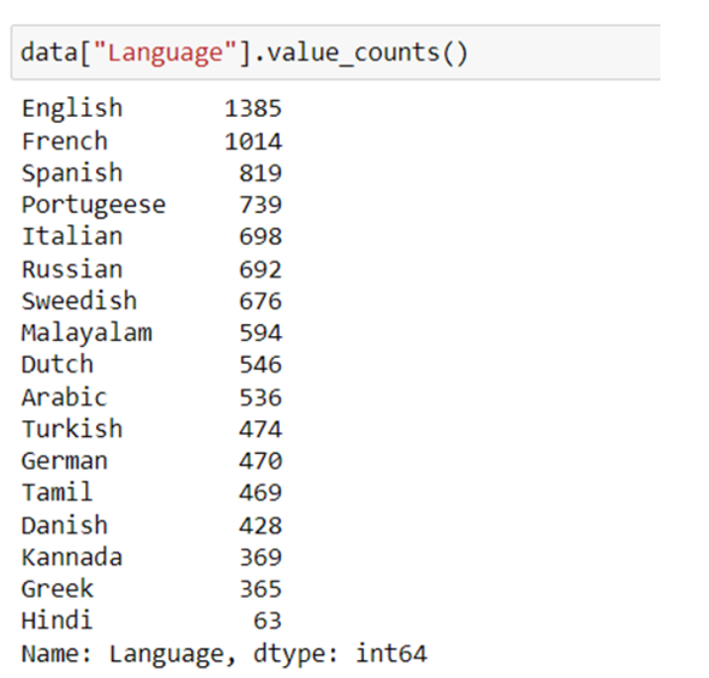
DATASET
This dataset contains 22 languages ​​with 1000 sentences from each language. Since this is a highly balanced dataset with no missing values, we can say that this dataset is perfectly ready to be used for training machine learning models.
Link for dataset :- https://drive.google.com/file/d/1afOiy8N5g-4-MCV8oElSK8VbxYdnRkfF/view?usp=share_link

Slide 4
CODE FOR LANGUAGE DETECTION
import pandas as pd
import numpy as np
import re
import seaborn as sns
import matplotlib.pyplot as plt
import warnings
warnings.simplefilter("ignore")
# Loading the dataset
data = pd.read_csv("/content/drive/MyDrive/Language_Detection.csv")
# value count for each language
data["Language"].value_counts()
# separating the independent and dependant features
X = data["Text"]
y = data["Language"]
# converting categorical variables to numerical
from sklearn.preprocessing import LabelEncoder
le = LabelEncoder()
y = le.fit_transform(y)
# creating a list for appending the preprocessed text
data_list = []
# iterating through all the text
for text in X:

Slide 5
# removing the symbols and numbers
text = re.sub(r'[!@#$(),n"%^*?:;~`0-9]', ' ', text)
text = re.sub(r'[[]]', ' ', text)
# converting the text to lower case
text = text.lower()
# appending to data_list
data_list.append(text)
# creating bag of words using countvectorizer
from sklearn.feature_extraction.text import CountVectorizer
cv = CountVectorizer()
X = cv.fit_transform(data_list).toarray()
#train test splitting
from sklearn.model_selection import train_test_split
x_train, x_test, y_train, y_test = train_test_split(X, y, test_size = 0.20)
#model creation and prediction
from sklearn.naive_bayes import MultinomialNB
model = MultinomialNB()
model.fit(x_train, y_train)
# prediction
y_pred = model.predict(x_test)
# model evaluation
from sklearn.metrics import accuracy_score, confusion_matrix
ac = accuracy_score(y_test, y_pred)
cm = confusion_matrix(y_test, y_pred)
# visualising the confusion matrix
plt.figure(figsize=(15,10))
sns.heatmap(cm, annot = True)

Slide 6
plt.show()
# function for predicting language
def predict(text):
x = cv.transform([text]).toarray()
lang = model.predict(x)
lang = le.inverse_transform(lang)
print("The langauge is in",lang[0])
predict("My name is Uday Singh Shergill and this is my NLP project.")
predict("Je m’appelle Uday Singh Shergill et voici mon projet NLP.")
predict("اسمي عدي سينغ شيرجيل وهذا هو مشروع البرمجة اللغوية العصبية الخاص بي")
predict("Mi nombre es Uday Singh Shergill y este es mi proyecto de PNL")
predict("എന്റെ പേര് ഉദയ് സിംഗ് ഷെർഗിൽ, ഇത് എന്റെ എൻഎൽപി പ്രോജക്റ്റ്.")
predict("Меня зовут Удай Сингх Шергилл, и это мой НЛП-проект.")
predict("मेरा नाम उदय सिंह शेरगिल है और यह मेरा एनएलपी प्रोजेक्ट है।")

Slide 7
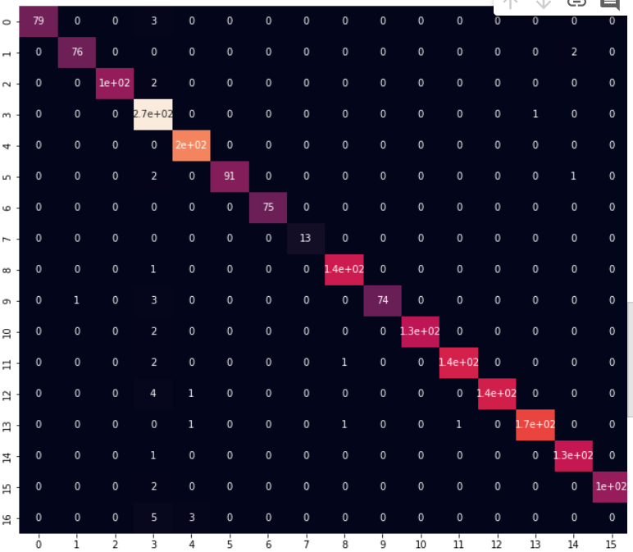
OUTPUT

Slide 8
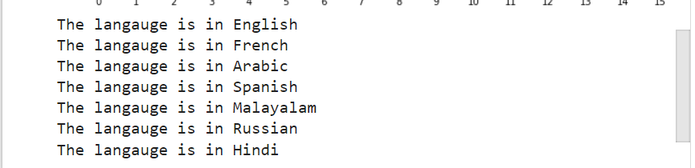

Slide 9
FUTURE WORK
APART FROM THE DATASET, WE CAN ALSO ADD THE CODE WHICH WILL HELP IN TRANSLATING THE SENTENCE FROM ONE LANGUAGE TO ANOTHER.

Slide 10
THANK YOU

